Slide 1
Dr.M.Mohammadrahimi
Assistant Professor
Department of Urology, Tabriz University of Medical Sciences

Slide 2
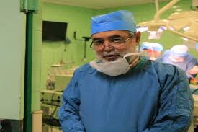
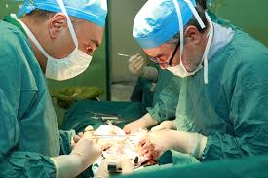
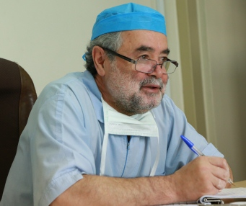

Slide 3
Vascular Complications in Renal transplantations

Slide 4
PREOPERATIVE ASSESSMENT
Patent iliac artery and vein with unimpeded proximal blood flow that are able to be sutured
Surgical access can be difficult because of a polycystic kidney, obesity, or a failed previous kidney
transplant
Extensive mural arterial calcification can make clamping and suturing impossible without disruption of the artery

Slide 5
Prefer the left donor kidney
Its longer renal vein and shorter artery
The longer left renal vein is less fragile and more easily sutured to the more deeply situated external iliac vein than the short right renal vein
The right renal artery anastomosis is more difficult to site because of its propensity to kink

Slide 6
Technical graft failure rate is higher with the right kidney from a living donor

Slide 7
Anastomosis of the deceased donor right renal vein can be facilitated ▼
by vein elongation using the adjacent donor inferior vena cava or a donor iliac vein extension graft

Slide 8
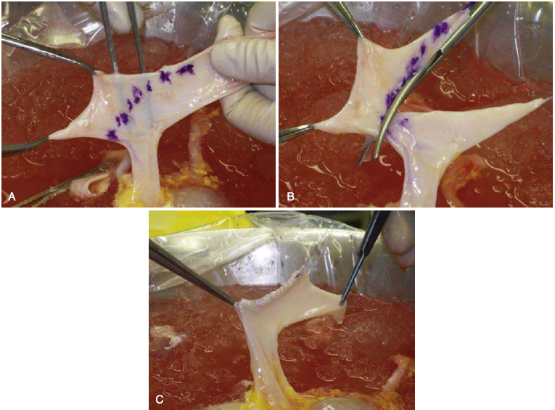

Slide 9
In living donor right kidneys
The recipient external iliac vein can be mobilized by dividing the internal iliac veins
Creation of a vein extension using the gonadal vein in the live donor kidney has also been described, but in practice is rarely necessary

Slide 11
Arteries may have been
missed or divided
Atheromatous plaque, clot, or an intimal flap may be impinging on the lumen of the renal artery
Inadvertent traction or a donor surgeon's wayward scissor may have torn or injured the donor renal vein

Slide 12
TRANSPLANT RENAL VEIN ANASTOMOSIS

Slide 13
systemic heparinization for the vascular anastomoses is not necessary
The site of the iliac vein anastomosis can be marked
Accurate sizing of the venotomy length prevents stretching of the end of the transplant renal vein

Slide 14
After opening the vein, the surgeon searches for pairs of valve cusps
A stay suture is applied to the midpoint of at least one of the sides

Slide 15
A thrombosed or stenosed external iliac vein is identified by color Doppler ultrasound scanning (CDUS) should be considered in patients
history of deep vein thrombosis (DVT)
previous transplant Surgery
unilateral leg swelling
emergency dialysis access via the femoral vein

Slide 16
The external iliac veins in an obese recipient or a short, muscular male patient with a deep pelvis and almost vertically disposed external iliac vein▼▼
can be challenging, particularly for right-sided donor kidneys placed in the left iliac fossa►►►

Slide 17
For ease of access
It is tempting to place the venous anastomosis close to the inguinal ligament, but there is a risk of compression of the renal vein during wound closure.
Options include lengthening of the donor renal vein or the sometimes difficult task of mobilization of the external iliac vein by dividing the internal
iliac vein and its tributaries
The surgeon should ensure that there are long stumps on the ligated veins

Slide 18
TRANSPLANT RENAL ARTERY ANASTOMOSIS

Slide 19
The extent of dissection of the iliac artery should be limited to diminish the risk of disruption of adjacent lymphatic channels If the internal iliac artery is to be used
The surgeon fully mobilizes the bifurcation of the common iliac artery and carefully examines the origin for an athero- matous plaque

Slide 20
Use of the internal iliac artery is avoided if the opposite side artery has been involved in a previous Transplant
The bifurcation or trifurcation of the internal iliac artery should be preserved to reduce the risk of buttock claudication.

Slide 21
If both internal iliac arteries have been used for transplantation, claudication is inevitable as is impotence.

Slide 22
Arterial clamps are applied with care to avoid damage or rupturing plaques
Endarterectomy can often be avoided by carefully selecting a soft segment of artery
To avoid kinking during wound closure, the renal artery length can be adjusted by resecting the donor aortic patch and implanting as in a live donor kidney

Slide 23
The shortened artery of the right kidney can be anastomosed to the end of the internal iliac artery
deeper placement of the transplant anastomoses
less tension on the short right renal vein
easy positioning of the kidney after revascularization

Slide 24
Small accessory renal arteries, particularly at the upper pole, can be ligated without problem
lower-pole arteries that often contribute blood supply to the donor ureter

Slide 25
Anastomosis of two arteries close together on an aortic patch of a left-sided deceased donor kidney is comparatively straightforward
dual arteries to a right- sided kidney make positioning of the kidney difficult without kinking one or the other artery

Slide 26
Multiple arteries
can be pantalooned on the back table to create a single arterial orifice, minimizing anastomosis time
separate anastomoses can be formed, although warm ischemic time will inevitably be longer

Slide 27
REPERFUSION
high point of the transplant procedure
there is no turning back.

Slide 28
Before completing the arterial anastomosis, air is excluded from the clamped vessels by injecting heparinized saline
Fixed retractors that might compress proximal iliac vessels are reviewed and individ ual anastomoses are tested before revascularization of the transplanted kidney

Slide 29
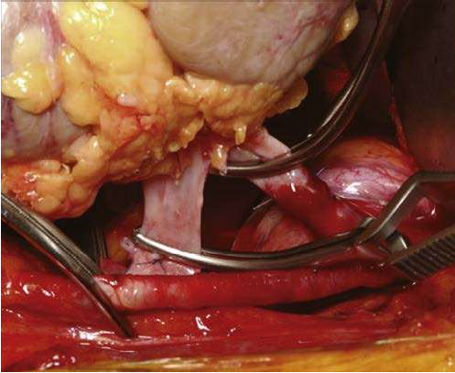

Slide 30
The proximal arterial clamp and venous clamps are released first
The last clamp removed is the distal iliac artery clamp after systemic blood pressure has stabilized after reperfusion of the kidney
Observation of urine within a couple of minutes is a reassuring sight
A pink, firm, and well-perfused kidney is the next best thing
.

Slide 31
Kidneys from marginal donors or with long renal ischemia times may have a "blotchy" or mottled appearance with dark, less well-perfused areas
An encouraging sign is the gradual reduction in extent of the dark areas until the kidney is uniformly pink

Slide 32
A flaccid, poorly perfused kidney is reason for concern
Modern tissue typing and crossmatching techniques have essentially excluded hyperacute rejection as a cause

Slide 33
The surgeon starts with inspection of the renl segmental
The kidney is soft but not necessarily discolored.
Anecdotal reports suggest that placement of a swab gener- ously soaked in papaverine around the artery and excision of affected artery adventitial tissue may help ►►

Slide 34
permission of the anesthetist, the iliac artery distal to the arterial anastomosis is clamped and diluted glycerol trinitrate injected into the proximal iliac artery

Slide 35
Spasm is usually self-limiting but can cause concern and warrant systemic heparinization

Slide 36
If no arterial inflow problem can be identified and systemic blood pressure is satisfactory, the surgeon should be patient
Particularly if the kidney swells when the renal vein is temporarily occluded (Hume test)
A small incision into the capsule of the kidney followed by evidence of bright arterial bleeding can also be reassuringas as can an on-table ultrasound.

Slide 37
During apposition of the abdominal wall muscles, the potential for kinking of the kidney transplant vasculature Increases
particularly in thin patients receiving large kidneys
male patients with a narrow deep pelvis
A venous anastomosis too close to the inguinal ligament
An incision too close to the anterior superior iliac spine..

Slide 38
If no urine has been seen on the operating table or in recovery:
ultrasound examination is useful

Slide 39
Thank you for your attention

